Slide 1
COVID-19 and Beyond: Investing in the Future of Health Security
BARDA: Division of
Research Innovation and Ventures (DRIVe)
Sandeep Patel, PhD
AAAS S&T Policy Orientation, September 9, 2020

Slide 2
“Never doubt that a small group of thoughtful, committed citizens can change the world; indeed, it's the only thing that ever has.”
-Margaret Mead
“It is not the critic who counts; not the man who points out how the strong man stumbles, or where the doer of deeds could have done them better. The credit belongs to the man who is actually in the arena, whose face is marred by dust and sweat and blood; who strives valiantly; who errs, who comes short again and again, because there is no effort without error and shortcoming; but who does actually strive to do the deeds; who knows great enthusiasms, the great devotions; who spends himself in a worthy cause; who at the best knows in the end the triumph of high achievement, and who at the worst, if he fails, at least fails while daring greatly, so that his place shall never be with those cold and timid souls who neither know victory nor defeat.”
-Teddy Roosevelt

Slide 3



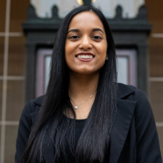

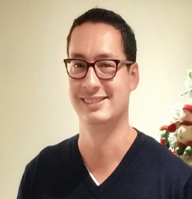

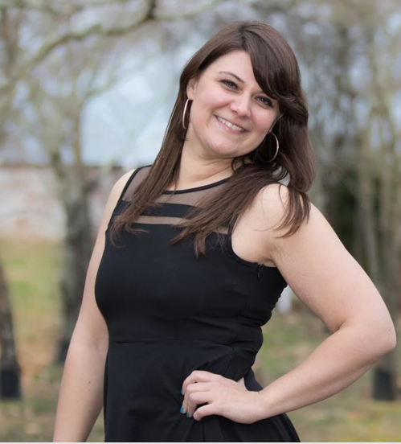
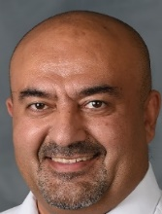
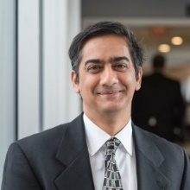

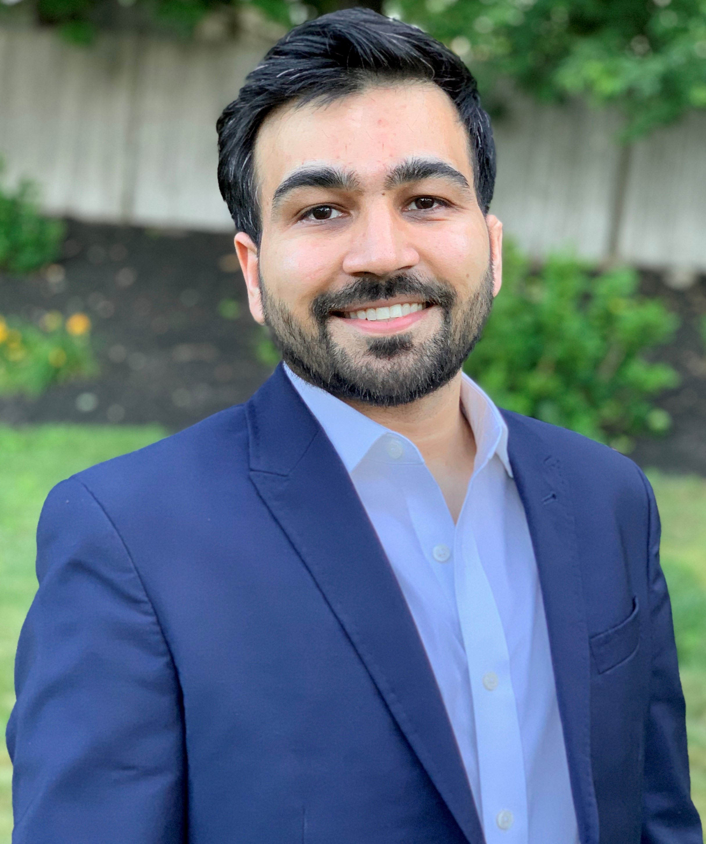


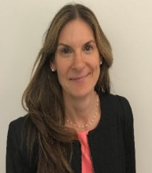
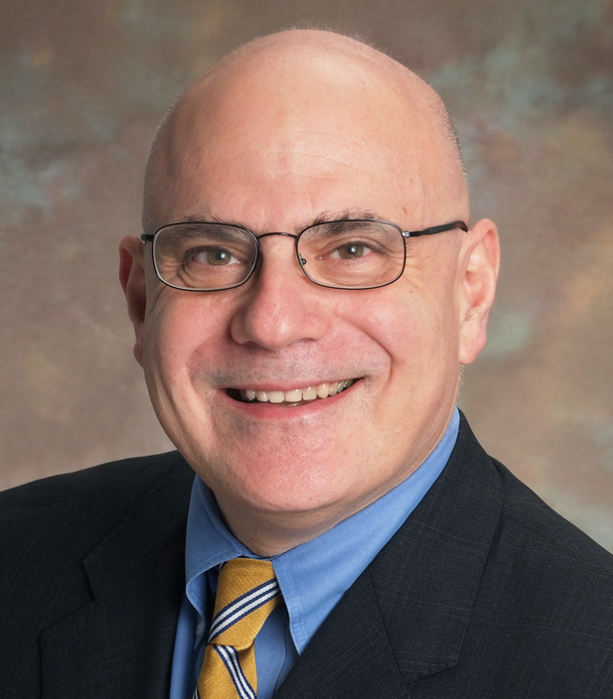
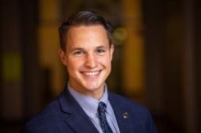

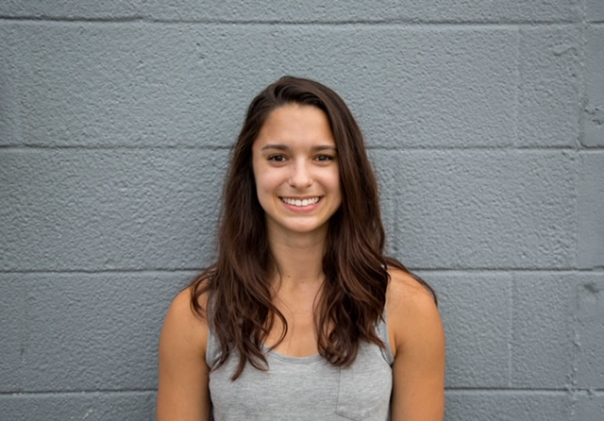

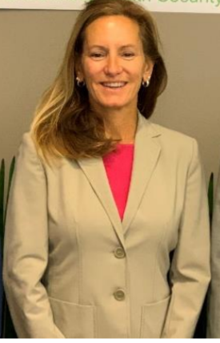
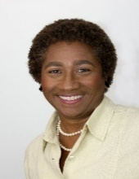


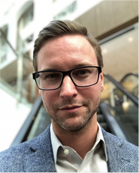




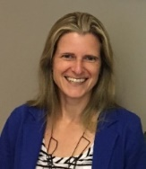

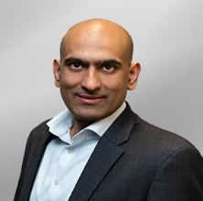
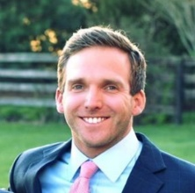
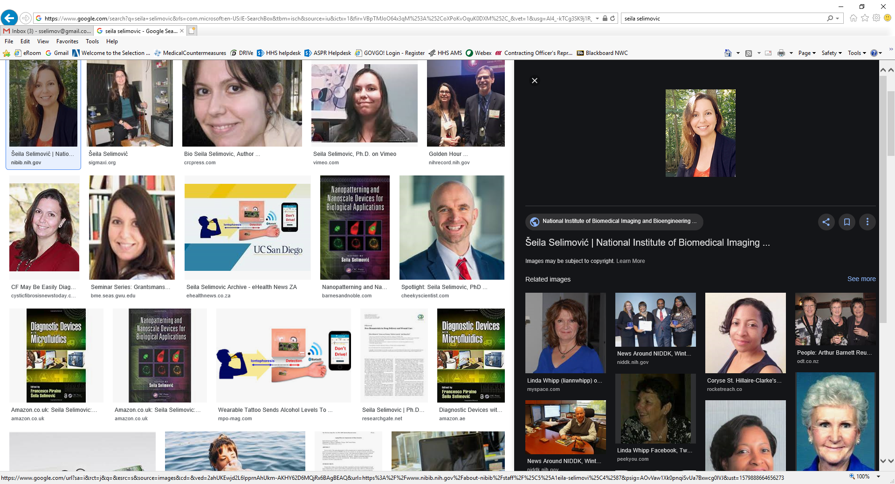

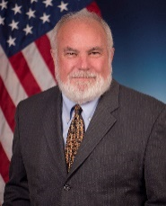
Team Photo at 2020 Annual Retreat
Meet Team

Slide 4




BARDA Program Divisions
Medical Countermeasures (MCM) Program
Influenza & Emerging Infectious Diseases
Chemical, biological, radiological and nuclear (CBRN) Program
Detection, Diagnostics, & Device Infrastructure
Pharmaceutical Countermeasure Infrastructure
Division of Research, Innovation, and Ventures (DRIVe)

Slide 5

DRIVe’s Approach to Innovation
We change how government approaches big health security challenges and threats
We tackle health security threats by seeking breakthrough devices and technologies
We model our work on the best practices of the entrepreneurial world
We use tools and authorities to support new technologies, streamline contracting processes, and launch a network of accelerators
The team is comprised of scientists and venture entrepreneurs dedicated to identifying threats to health security

Slide 6
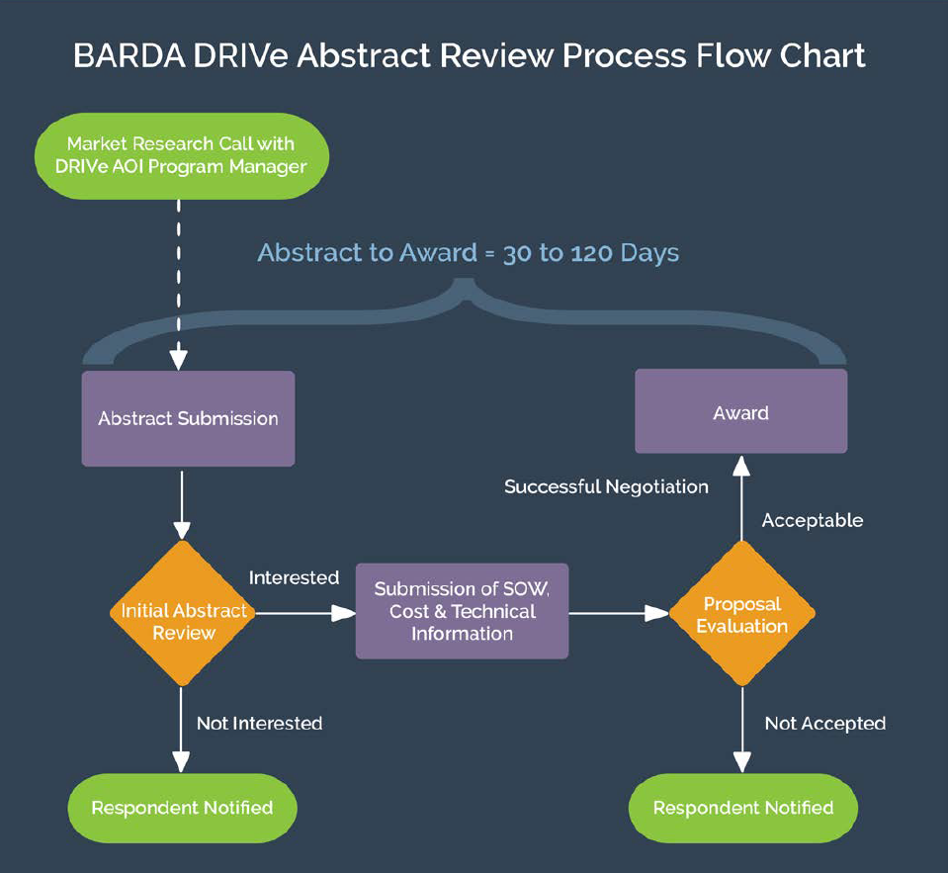
DRIVe R&D Funding Vehicle
Easy Broad Agency Announcement (EZ-BAA) is designed to be fast, easy-to-use, and flexible
Inspired by DARPA
$749,999 max & 30-50% cost share requirement
Can go from posting solicitation to award within 30 days

Slide 7



DRIVe Program Areas
ENACT
SEPSIS
DRIVe Interface Office
Supporting pathogen-agnostic technologies that enable earlier infection diagnoses
Reducing the incidence, morbidity, mortality, and cost of sepsis
Bridging the intersection between the science and the business world

Slide 8












ENACT: Strategy and Investments
Act –
Pre-symptomatic information: Empowering patients
MICRONEEDLE
Treat –
Early diagnostics for medical care providers
LAB-ON-A-DUST
Control –
Actionable information for health care organizations
Notes:
Technologies:
1.) Non-invasive health monitoring: smart devices (Spire washable tag, Biobeat watch, Empatica wristband)
2.) Non-invasive health monitoring: Smart app (Evidation)
3.) On-body continuous monitoring devices (Sonica sticker, EnLiSense band, Stanford Medicine microneedle patch, UC San Diego wearable focused ultrasound system
4.) In-home monitoring (Sound Life Sciences)
5.) Telehealth (98point6)
6.) Point-of-care / on-demand analysis (Rizlab Health cytotracker, Stanford Medicine Lab-on-a-Dust, GE Healthcare ultrasound detector)

Slide 9

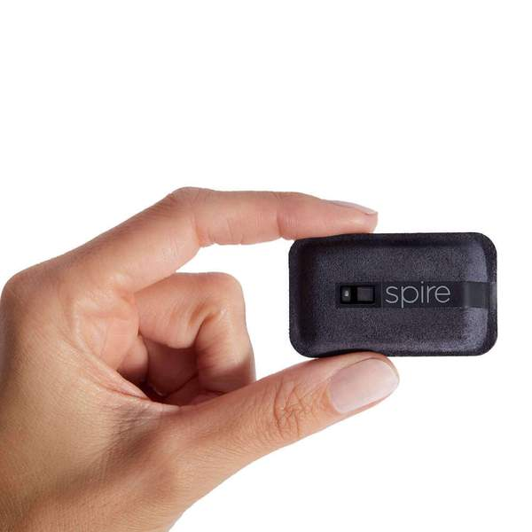

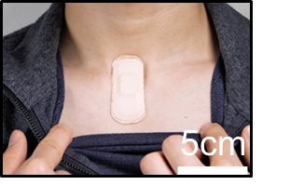
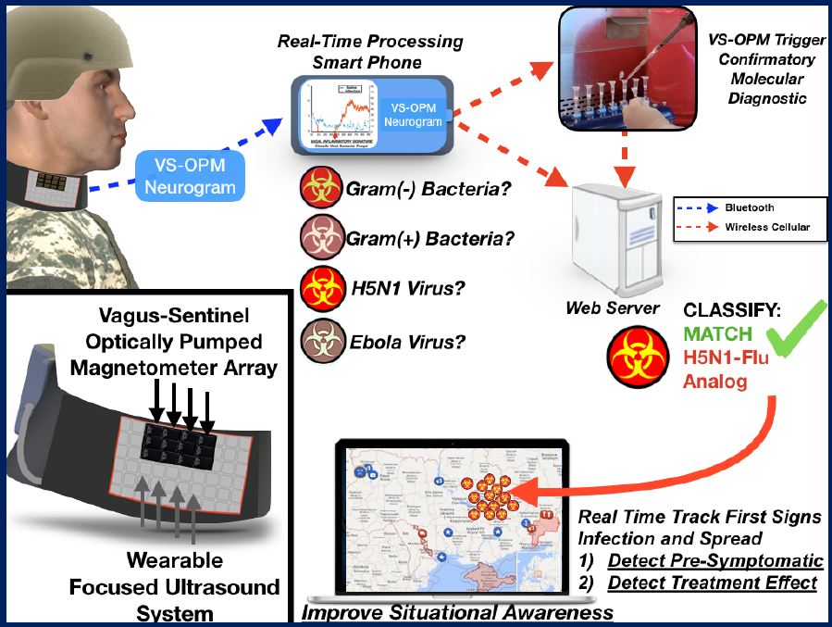

Biophysical Continuous Monitoring Devices
wearable focused ultrasound system
Respiration rate tracking equivalent to medical grade monitoring
Heart rate and heart rate variability
Sleep / sleep quality
Activity
Stress
Vagus nerve firing indicates immune system status
Bacterial vs viral infections
Detects pre-symptomatic infection
Detects treatment effect
Real-time tracking
Acousto-mechanic sensing
Assesses cardio-pulmonary health
Vital sign monitoring
Notes:
I would differentiate Slide 9 (Purely Biophysical continuous monitoring) from Slide 11 (Bio chemical continuous monitoring) and group Sonica and UCSD with Spire, BioBeat and Empatica
Sonica: Advanced, acoustomechanic (ADAM) system provides comprehensive assessment of cardiopulmonary health employing low power, in-sensor analytics & cloud integration.
ADAM’s full suite of digital biomarkers:
1) Predict for impending respiratory infection
2) Warn of continued infectiousness
3) Identify treatment non-responders
4) First responders can apply patch for continuous vital sign monitoring
UC San Diego: Low-profile wearable device that can be worn on demand
Measuring changes in vagus nerve firing indicates immune system status and activation
Device is envisioned to detect pre-symptomatic infections anywhere in the body
Allow individuals to monitor themselves for signs of impending disease
Allow clinicians to monitor patients after discharge for infection
Enhance capabilities of first responders to monitor patients in transit
Ge: StimResponse: Novel Ultrasound Immune Response Profiling Tool for Pre- symptomatic Pathogen Exposure Detection
Concept: Non-invasive ultrasound test will detect pre-symptomatic exposure to pathogens via development of stress model involving biomarker signatures and stimulation inputs.
No biological sample required.
Ultrasound to different body locations drives different immune cell response profiles
Expanding use of technology from therapeutic (DARPA) to diagnostic (BARDA)
Biomarkers measured before and after ultrasound on subjects exposed to LPS, flu and pneumonia (multiple time points; non-exposed control subjects)
Stanford (middle):
Microneedle patch coupling electrodes to structure-switching aptamers.
Continuously monitors CRP, Glucose, IP10, TRAIL in the interstitial fluid
Can monitor multiple biomarkers once every 5 min. for up to 2 weeks
Enables pre-symptomatic monitoring and drug dose management in clinical trials or patient treatment/Emergency responders

Slide 10

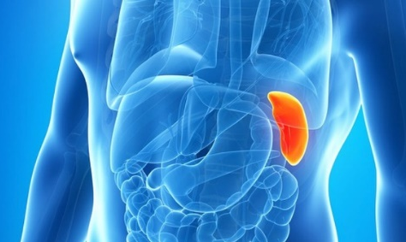
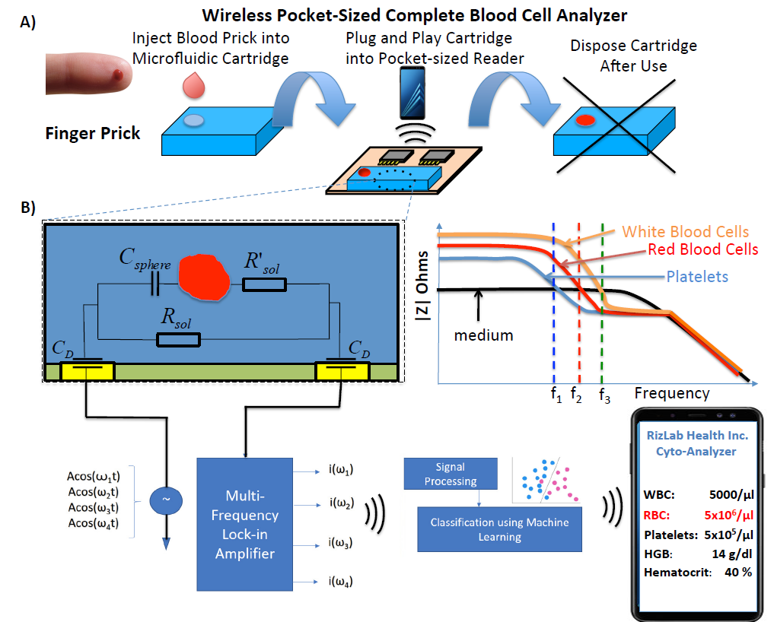
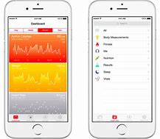
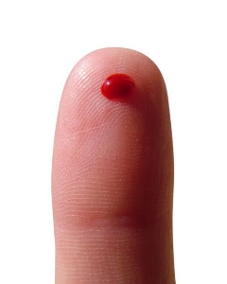

Point-of-Care Analysis
LYMPH
BM1 BM2 BM3
SPLEEN
BM1 BM2 BM3
Pocket-sized blood analyzer determines blood count, immune activation via cell morphology changes
Rapid test to distinguish viral from bacterial infection
Lab-on-a-Dust system (LDS)
CRP, TNF-alpha, IL-1RA
No prep; sample-to-answer: 15 min
Development of stress model involving biomarker signatures
Ultrasound detects changes in biomarker expression / immune cell responses
Tunable antibody switch constructs imbedded in disposable microchip
Notes:
Rizlab Health:
Data-Driven Home Monitoring System for Classifying Viral/Bacterial Infections
Pocket-sized blood analyzer provides CBC at the ER/Physicians’ Office/In The Home Utilizes impedance cytometry to count white blood cells and determine immune activation via morphological changes to those cells
Enables patients to perform a rapid virus/bacteria test to send to their clinician to enhance antibiotic stewardship
Enables first responders to get rapid CBC to enhance potential for life-saving treatments not now available before arrival at hospital
Stanford:
A fully integrated, RF powered, multiplexed, 1mm² MDx system on a disposable CMOS chip immersed in clinical sample and wirelessly transmits results to phone
no sample prep, instrumentation reagents required
Sample to answer: 15 min
Can be used for home-based diagnosis of disease, clinical trial monitoring, rapid triage by emergency responders
Prototype will detect CRP, TNF-a and IL-1RA at [pM] from a finger prick

Slide 11
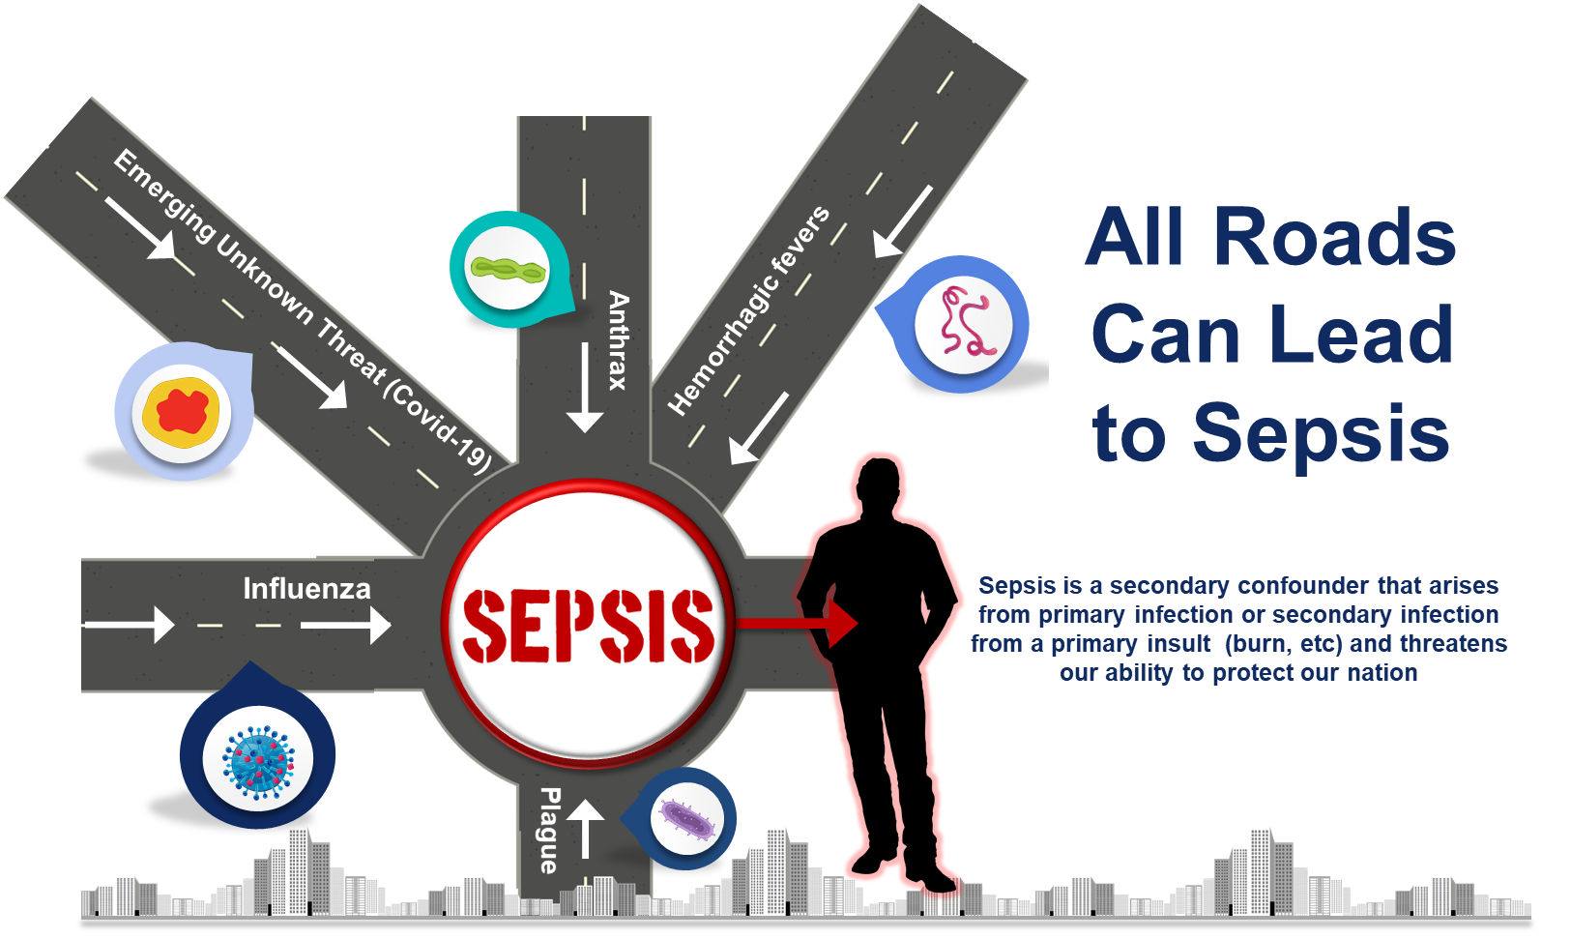

Slide 12







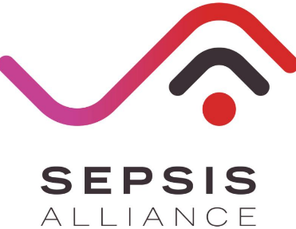









DRIVe Portfolio
25 funded companies
$30.7 million funded
$20.7 million cost share

Slide 13
DRIVe Catalyst Office
Equity investments pre/post EZ-BAA through BARDA Ventures
Incubate and launch new programs through DRIVe Start
Amplify and catalyze investments through the Accelerator Network
Develop market intelligence reports and landscapes
Lead efforts in scaling, transition, and advancement for all of DRIVe
The DRIVe Catalyst Office will close the gap between business and science
Bring both industry partners and government partners to the table
Constantly challenge the status quo

Slide 14
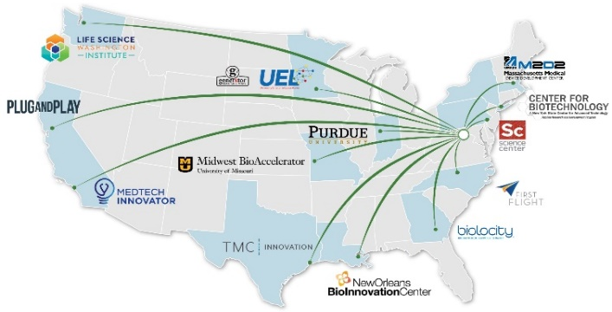
The DRIVe Accelerator Network
Tech Scouting, Wrap-around Support, Programs & Events, Networking
Identifying and connecting our early-stage R&D partners with regional accelerators to speed innovations in health security

Slide 15

BARDA Ventures
Initiative to redefine how USG partners with private sector to advance health security
21st Century Cures Act directed BARDA to enter into this partnership
Seeking to partner with an existing non-profit entity (Managing Entity) that will utilize “venture capital practices and methods to address urgent health security needs” through equity investing
Investing, developing, and harnessing technologies to improve preparedness posture against known and unknown threats

Slide 16



DRIVe Acquisitions Team: EZ-BAA 2.0 & COVID-19 Response
EZ-BAA
FEB 2020
500+
33
9
Opened for Business
Submissions Received
Contracts Executed
Fewest Number of Days from Abstract to Award
Notes:
Don’t say “hopefully” this will make it easier. It WILL make it easier.

Slide 17






























DRIVe COVID-19 Portfolio
33 funded companies
$19.5 million funded
$15.3 million cost share
Notes:
Total funding does not include the $7.3M awarded to Cytovale, Beckman Coulter, Sonica, and Sepsis Alliance that have partial COVID-19 Scope in the contract but exact dollar amount is hard to state

Slide 18

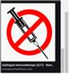
Emerging Program Areas
DRIVe has also created a new process called DRIVe Start to rapidly seed new program areas
COVID-19 Rapidly Deployable Capabilities
Vaccine Delivery
Triaging severely-ill and empowering patient self-monitoring
Developing alternatives to traditional needle/syringes to enable broader access

Slide 19






COVID-19 Rapidly Deployable Capabilities
Empower the Patient
Empower the Health Care Provider
Allocate Hospital Resources
Self-monitor for infection
Early detection of health deterioration → early testing, intervention, isolation (reduce spread)
Monitor mild/moderate illness during self- quarantine to determine when need hospital care
Remote monitoring of patients and determine need for escalated care; prognosticate outcomes
Triage severely ill to determine need for Hospital care (~20%) /ICU (~5%) care
Identify health deterioration or decompensation in patients that need care to allocate/shift resources (personnel, equipment, etc.)
Multi-partner collaboration collating wearable & testing data to assess high-risk individuals (HCPs) and stratify risk
Vital Solution wearable (FDA cleared) to monitor nursing home patients (VA) and COVID-19 patients for health deterioration
Rapid sepsis diagnostic COVID-19 Pilot study: ED, respiratory illness PUI to triage for viral sepsis
Aura, an early warning platform for COVID-19 infection to facilitate early intervention
COVID-19 webinars for Healthcare professionals
Machine learning algorithm based on vital sign (EHR) and clinical data (MDW, FDA cleared) to detect viral sepsis
Expanding on existing partnership to include early identification of COVID-19 via wearable sensors​
Blood based host biomarker in vitro diagnostic to inform on sepsis (ICU and ED)

Slide 20

Questions?
DRIVe.hhs.gov
Sandeep Patel, PhD
DRIVe Director
Sandeep.Patel@hhs.gov
@innovationwonk

Slide 21
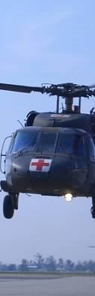
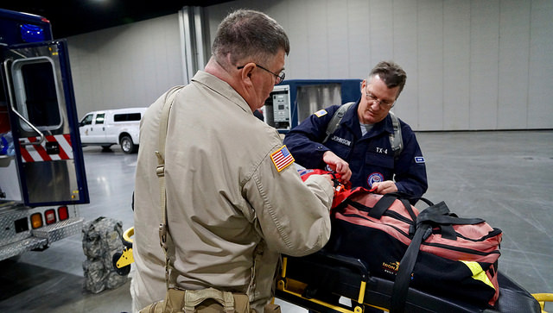
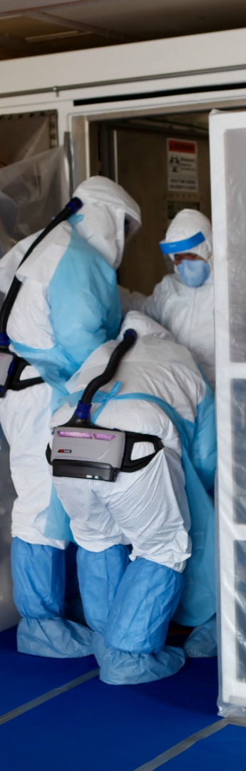
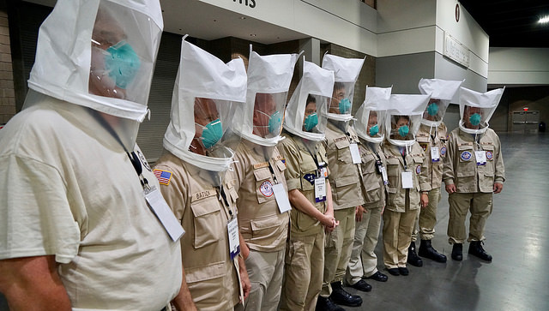

ASPR Mission
Save Lives and Protect Americans from 21st Century Health Security Threats

Slide 22











How to Contact BARDA
medicalcountermeasures.gov Portal to BARDA: Register to request a TechWatch meeting!
beta.sam.gov/ Official announcements and info for all government contract solicitations
phe.gov/BARDA Program description, information, news, announcements
drive.hhs.gov Learn about DRIVe, including our Accelerator Network and EZ BAA
www.usajobs.gov Join the team!

Slide 23











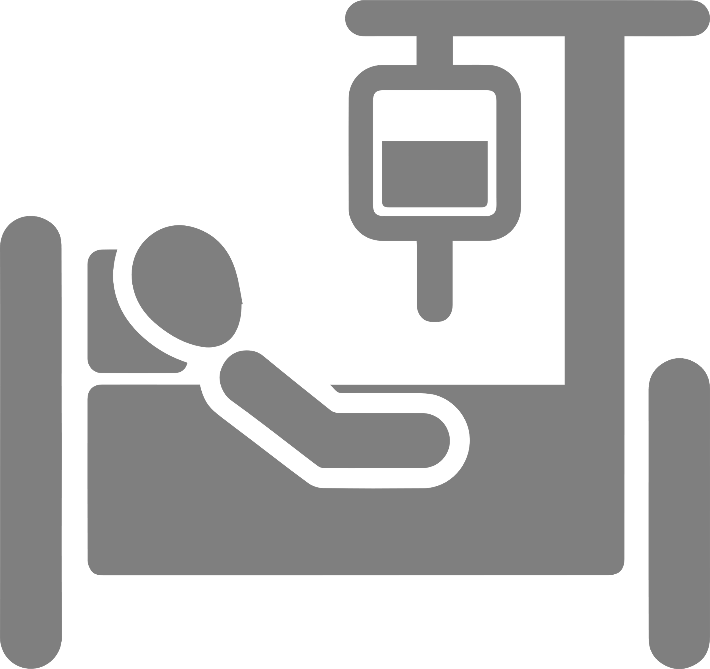
COVID-19 Continuum of Care
SURVIVAL Resilience
Community Mild Illness (~80%)
Severe Infection (~20%)
HOSPITAL DISCHARGE
ASYMPTOMATIC
SYMPTOM
ONSET
MILD ILLNESS
VIRAL PNEUMONIA
SEPTIC SHOCK
PREVENTION
INFECTION
SEPSIS
ARDS
LONG TERM SEQUELAE
Threat Agnostic Approach
MORTALITY
AWARENESS
PREDICTION
DIAGNOSIS
PROGNOSIS
TREATMENT
RECOVERY
Educate/Public Awareness
Training webinars
Diagnostic Tools for Disease Severity
EHR digital tools
host-based blood IV Diagnostics
Host-based therapeutics
Post-ICU discharge/Long-Terms Sequelae
Diagnose deterioration

